Slide 1
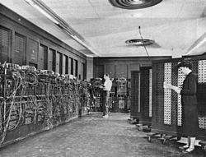
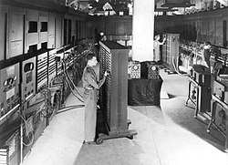
ENIAC - background
Electronic Numerical Integrator And Computer (ENIAC)
John Mauchly and J. Presper Eckert
University of Pennsylvania
Ballistic Research Laboratory
calculate artillery firing tables of US Army
Started 1943
Finished 1946
Too late for war effort
Used until 1955
Notes:
<number>

Slide 2
ENIAC - details
Decimal (not binary)
20 accumulators of 10 digits
Programmed manually by switches
30 tons
1,500 square feet
140 kW power consumption
5,000 additions per second
Notes:
<number>

Slide 3
Von Neumann/Turing
Stored Program concept (Memory comes to picture)
Main memory storing programs and data
ALU operating on binary data
Control unit interpreting instructions from memory and executing
Input and output equipment operated by control unit
Princeton Institute for Advanced Studies (IAS)
Completed
Notes:
<number>

Slide 4
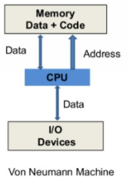
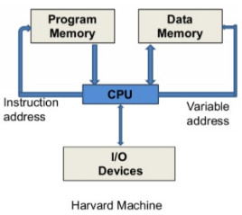
VON NEUMANN ARCHITECTURE | HARVARD ARCHITECTURE
It is ancient computer architecture based on stored program computer concept. | It is modern computer architecture based on Harvard Mark I relay based model.
Same physical memory address is used for instructions and data. | Separate physical memory address is used for instructions and data.
There is common bus for data and instruction transfer. | Separate buses are used for transferring data and instruction.
Two clock cycles are required to execute single instruction. | An instruction is executed in a single cycle.
It is cheaper in cost. | It is costly than von neumann architecture.
CPU can not access instructions and read/write at the same time. | CPU can access instructions and read/write at the same time.
It is used in personal computers and small computers because we need to change the program in RAM. | It is used in micro controllers and signal processing. In these applications the program is already dumped in to the ROM.

Slide 5
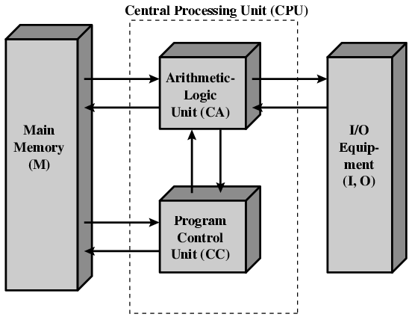
Structure of von Neumann machine
CA: Central Arithmetic
CC: Central Control
Notes:
<number>

Slide 6
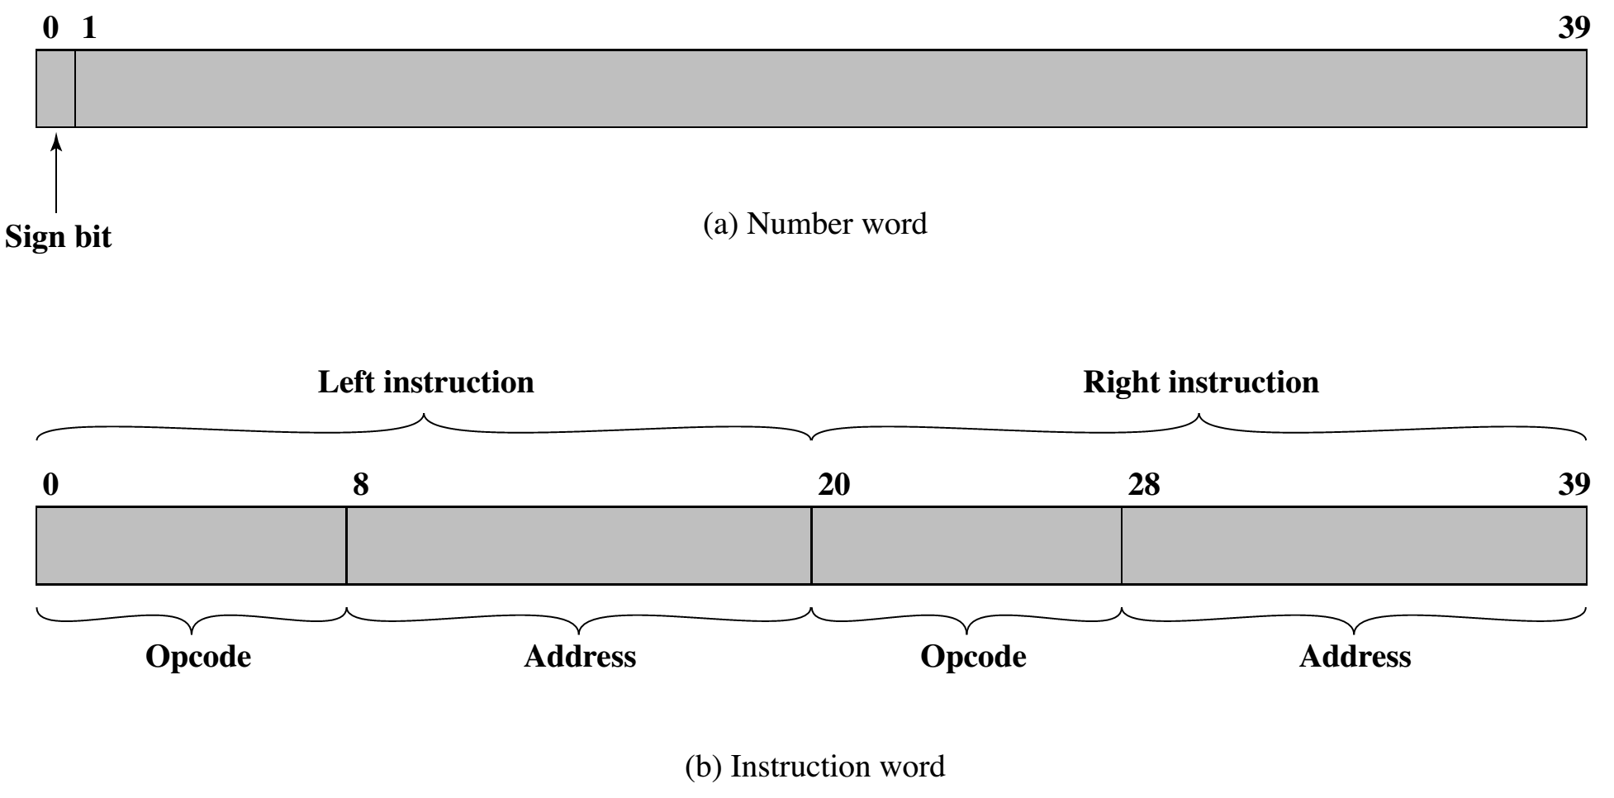
IAS – Memory format
4096 x 40 bit words
Binary number Main memory
2 x 20 bit instructions
Notes:
<number>

Slide 7
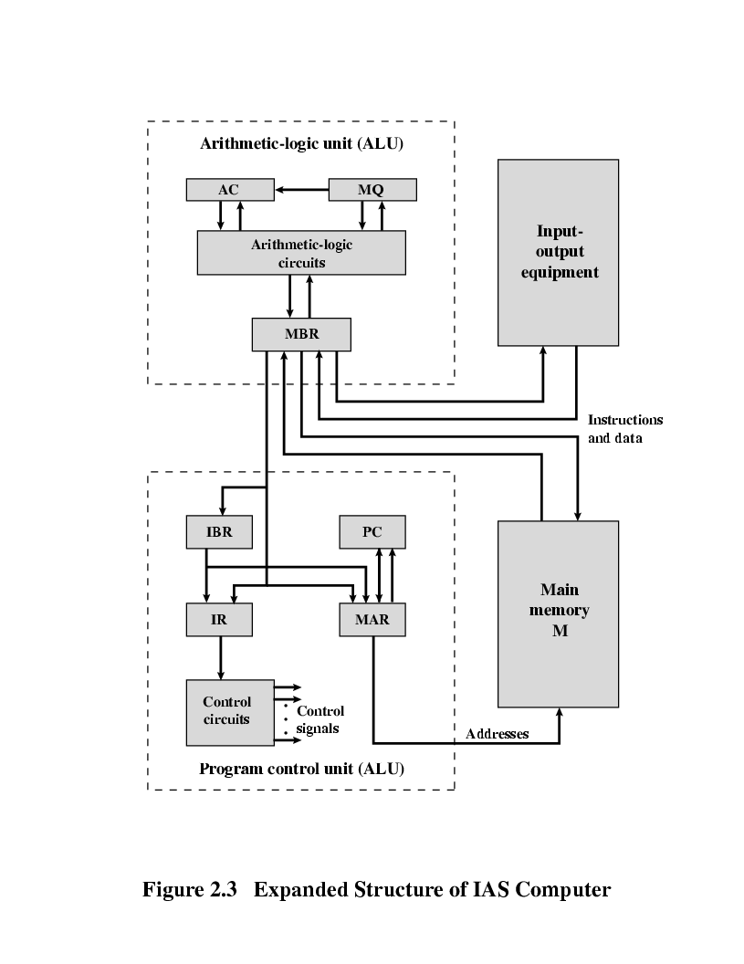
Structure of IAS – detail
Set of registers (storage in CPU)
Memory Buffer Register
Memory Address Register
Instruction Register
Instruction Buffer Register
Program Counter
Accumulator
Multiplier Quotient
Notes:
<number>

Slide 8
Memory buffer register (MBR): Contains a word to be stored in memory or sent to the I/O unit, or is used to receive a word from memory or from the I/O unit.
Memory address register (MAR): Specifies the address in memory of the word to be written from or read into the MBR.
Instruction register (IR): Contains the 8-bit opcode instruction being executed.
Instruction buffer register (IBR): Employed to hold temporarily the right hand instruction from a word in memory.
Program counter (PC): Contains the address of the next instruction-pair to be fetched from memory.
Accumulator (AC) and multiplier quotient (MQ): Employed to hold temporarily operands and results of ALU operations. For example, the result of multiplying two 40-bit numbers is an 80-bit number; the most significant 40 bits are stored in the AC and the least significant in the MQ.

Slide 9
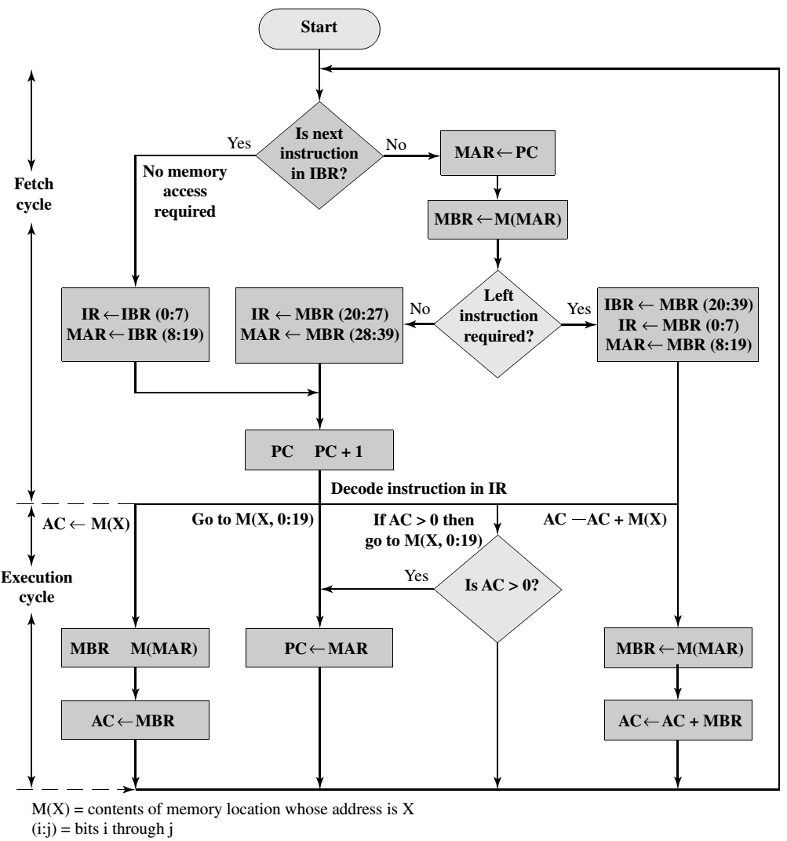
Instruction cycle

Slide 10
Explanation of instruction cycle
The IAS operates by repetitively performing an instruction cycle, as shown in
last Figure. Each instruction cycle consists of two subcycles.
During the fetch cycle, the opcode of the next instruction is loaded into the IR and the address portion is loaded into the MAR. This instruction may be taken from the IBR, or it can be obtained from memory by loading a word into the MBR, and then down to the IBR, IR, and MAR.
Once the opcode is in the IR, the execute cycle is performed.
Control circuitry interprets the opcode and executes the instruction by sending out the appropriate control signals to cause data to be moved or an operation to be performed by the ALU.

Slide 11
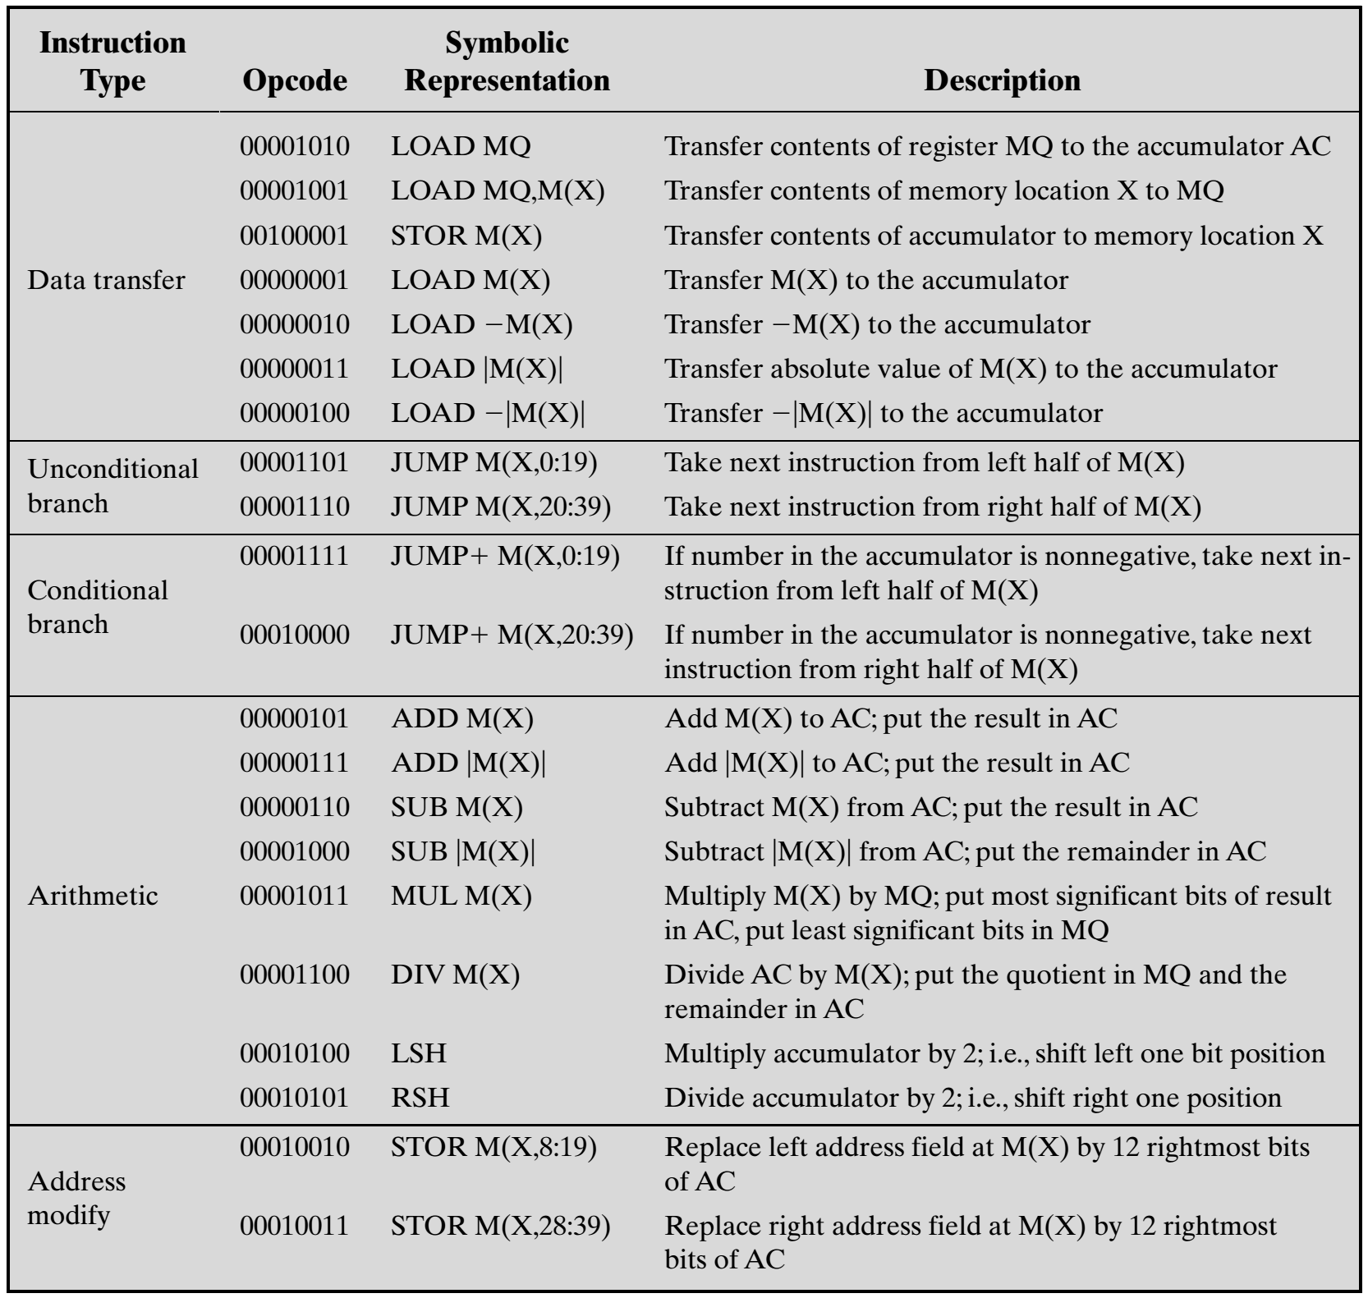
IAS Instruction set (21 instructions)
The IAS computer had a total of 21 instructions, which are listed in Table.
These can be grouped as follows:
Data transfer: Move data between memory and ALU registers or between two ALU registers.
Unconditional branch: Normally, the control unit executes instructions in sequence from memory. This sequence can be changed by a branch instruction, which facilitates repetitive operations.
Conditional branch: The branch can be made dependent on a condition, thus allowing decision points.
Arithmetic: Operations performed by the ALU.
Address modify: Permits addresses to be computed in the ALU and then inserted into instructions stored in memory. This allows a program considerable addressing flexibility.

Slide 12
Example of addition
1. LOAD M(X) 500, ADD M(X) 501 (PC=1)
2. STOR M(X) 500, Other instruction (PC=2)
MAR<PC
MBR<M[MAR]
IBR<MBR[20:39]
IR<MBR[0:7]
MAR<MBR[8:19]
MBR<M[MAR]
AC<MBR
IR<IBR[0:7]
MAR<IBR[8:19]
PC<PC+1
MBR<M[MAR]
AC<AC+MBR
MAR<PC
MBR<M[MAR]
IBR<MBR[20:39]
IR<MBR[0:7]
MAR<MBR[8:19]
MBR<AC
M[MAR]<MBR
Address | Data (40 bits)
500 | Data1
501 | Data2
502 | Result
Address | Left Instruction 20 bits | Right Instruction 20 bits
001 | LOAD M(500) | ADD M(501)
002 | STOR M(502) | Other instruction
003

Slide 13
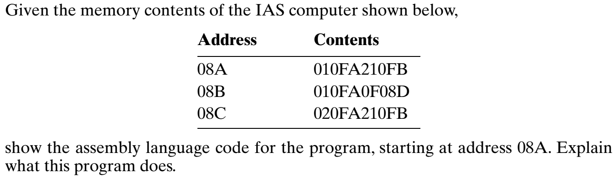
P1

Slide 14
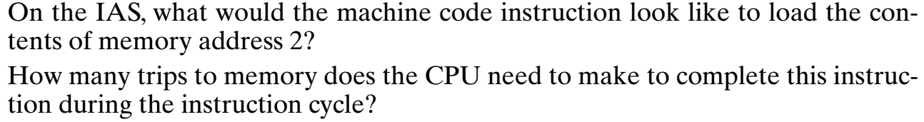
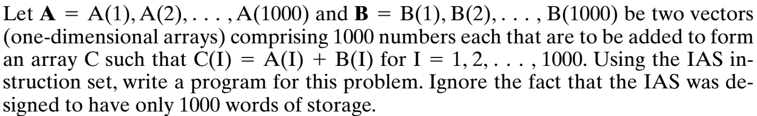
P2
P3

